Slide 1
Application Lifecycle Developer’s Guide to Windows 10

Slide 2
Agenda
Application lifecycle
Handling Suspension
Extended execution

Slide 3
Application lifecycle

Slide 4
Lifecycle?
Designed to protect device resources (battery especially)
OS runs one foreground app at a time on Mobile, more on Desktop
other apps are suspended and/or terminated
OS has many mechanisms for an app to appear ‘alive’
OS has controlled mechanisms for background code execution

Slide 5
App Lifecycle
Background task executes
Running
app
Suspended
app
Terminated
app
Suspending
Low memory
Resuming

Slide 6
Predictable behavior on every Windows device

Slide 7
Application Lifetime
Running
Suspended
Running
Suspended
Not Running
Memory
Launched
Suspended (5 seconds)
Activated
Suspended (5 seconds)
Terminated (no event)

Slide 8
launch, suspend, resume

Slide 9
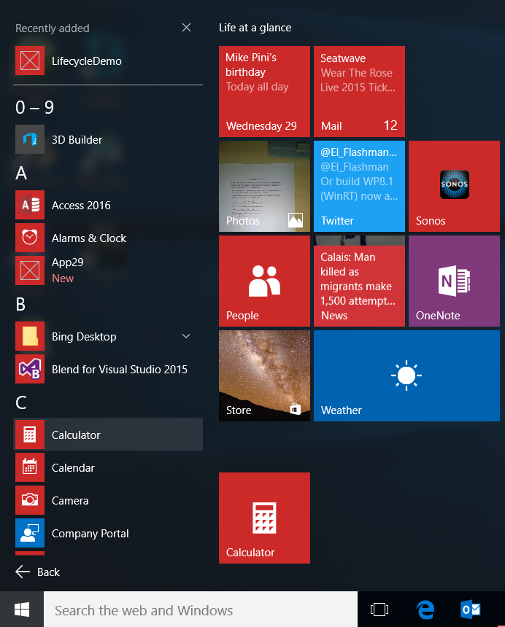
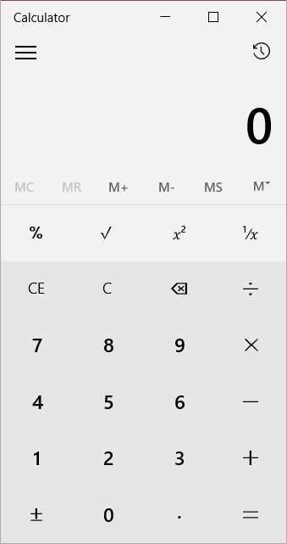
User launches app
Launch
NotRunning
Running

Slide 10
Application.OnLaunched override
sealed partial class App : Application
{
/// <summary>
/// Invoked when the application is launched normally by the end user.
/// </summary>
/// <param name="e">Details about the launch request and process.</param>
protected override void OnLaunched(LaunchActivatedEventArgs e)
{
// How did the app exit the last time it was run (if at all)
ApplicationExecutionState previousState = e.PreviousExecutionState;
// What kind of launch is this?
ActivationKind activationKind = e.Kind;
//..
NotRunning
Running
Suspended
Terminated
ClosedByUser
Launch
File
Protocol
VoiceCommand
Etc.

Slide 11
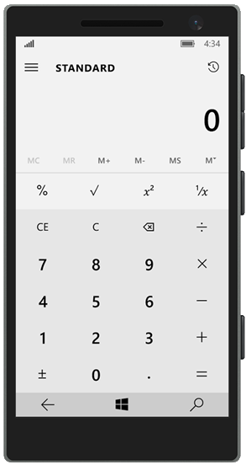
Your app is minimized or moves off screen
App is suspended
All code stopped
No timers tick
No events fire
Process still alive and in memory
Leaves App

Slide 12
On Desktop family, UWP apps suspend when they are minimized or when Windows enters a low power state

Slide 13
On Mobile, UWP apps suspend when no longer the foreground app

Slide 14
Application.Suspending event
sealed partial class App : Application
{
public App()
{
this.InitializeComponent();
this.Suspending += OnSuspending;
}
private void OnSuspending(object sender, SuspendingEventArgs e)
{
// Ask for a deferral if you need to do async work
var deferral = e.SuspendingOperation.GetDeferral();
//TODO: Save application state and stop any background activity
deferral.Complete(); // Then mark the deferral complete
}
This code has limited time to run. Doing the minimum amount of work here will improve the user’s experience of your app.
NB: Only ask for a deferral if you are doing async work. A deferral does not give you any more time to suspend.

Slide 15
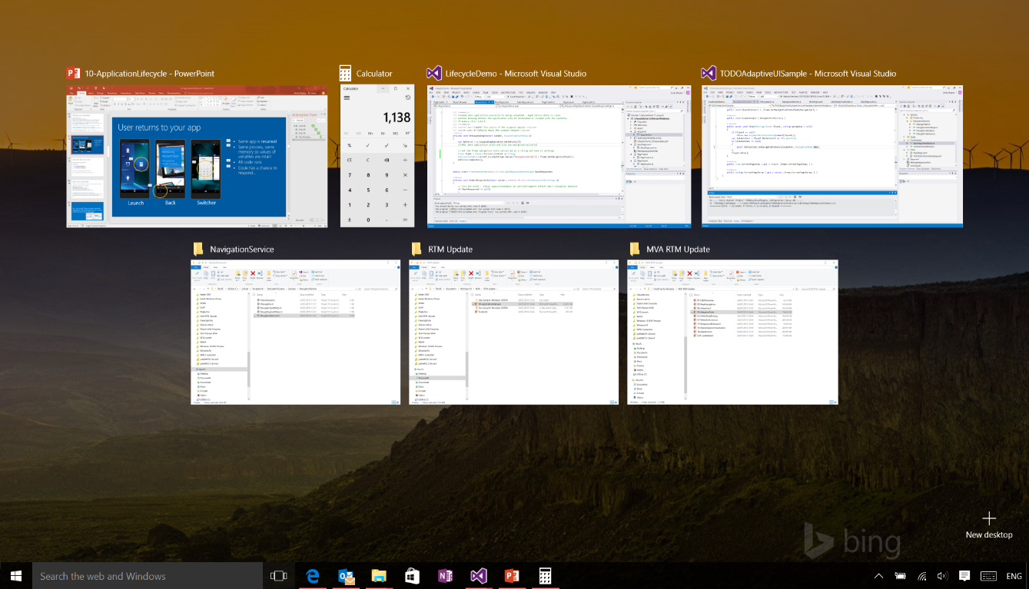
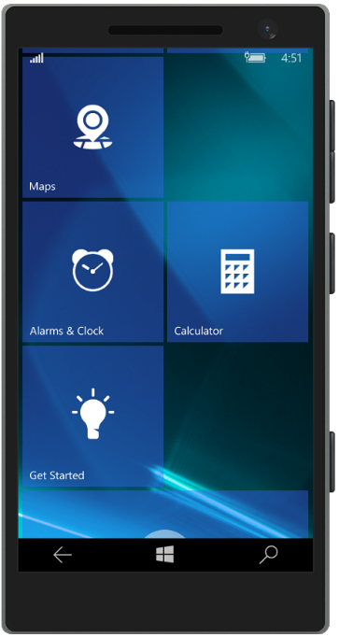
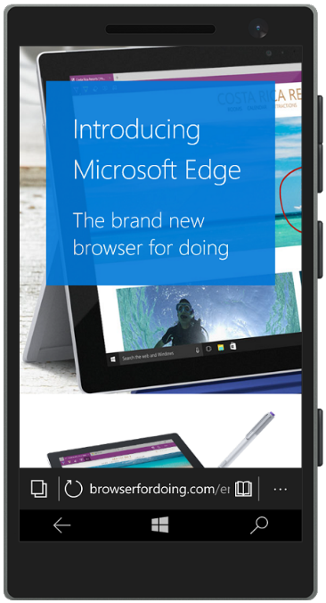
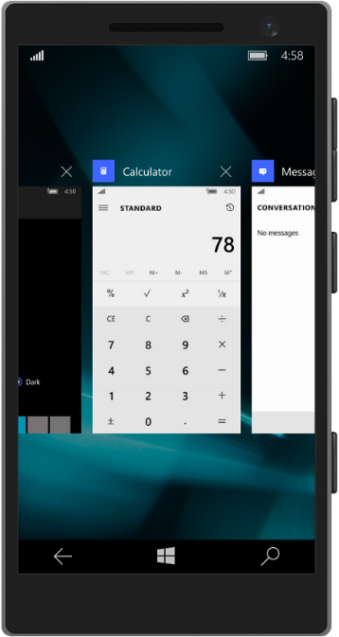
User returns to your app
Same app is resumed
Same process, same memory so values of variables are intact
All code runs
Code has a chance to respond...
Launch
Back
Switcher

Slide 16
Application.Resuming event
sealed partial class App : Application
{
public App()
{
this.InitializeComponent();
this.Suspending += OnSuspending;
this.Resuming += OnResuming;
}
private void OnResuming(object sender, object e)
{
// TODO: whatever you need to do to resume your app
}

Slide 17
What to do on resuming?
Check external data or conditions that might change while the app was suspended
refresh data from an online source
refresh the app’s view of connectivity – online or offline?
refresh sensor data such as compass, geolocation
retry a networking call that may have failed while suspended
check for new data populated by background tasks or system roaming
Consider time elapsed since suspension
When resuming after a short period of time, return users to the state the app was in when the user left.
When resuming after a long period of time, return users to your app's default landing page.
If appropriate, allow users to choose whether they want to restore their app to its previous state or start fresh

Slide 18
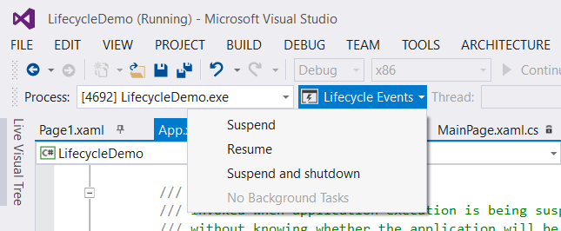
You must use the Debug Location toolbar to Suspend and Terminate apps that are running under the Visual Studio Debugger

Slide 19
Termination

Slide 20
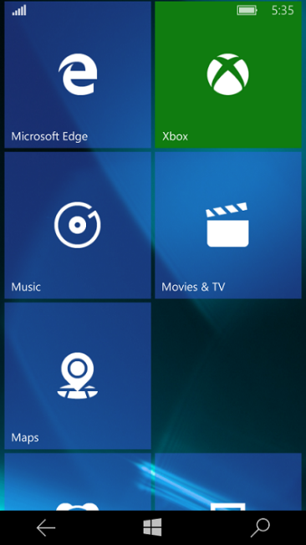
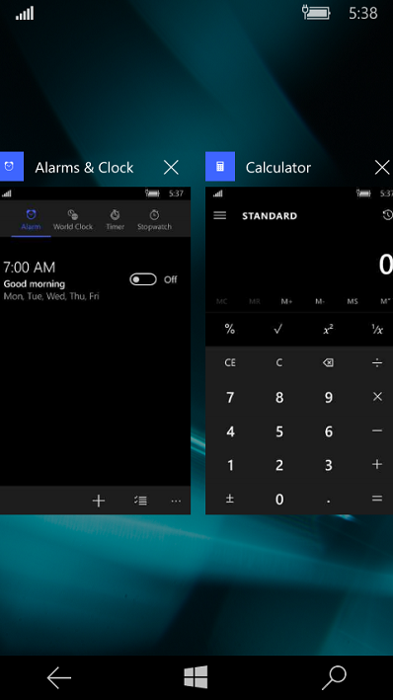
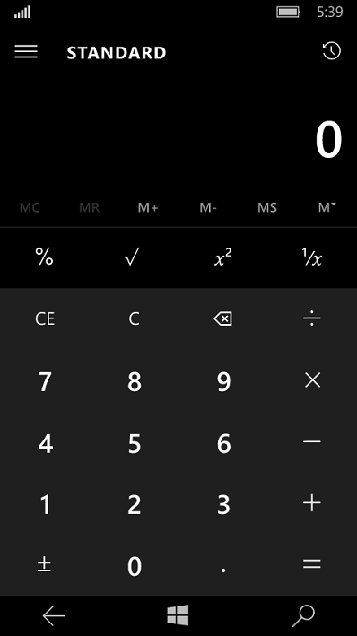
The OS can terminate your app
System has a priority system for determining which app to terminate.
Terminated
User Runs
Another App
OS Short of
Memory
OS Terminates
An App

Slide 21
The OS can terminate your app
Terminated
OS does not wake an app to terminate it – no notification
App is removed from task switcher list

Slide 22
User ‘returns’ to a terminated app
User will be unaware that the app was terminated
Would often expect that their experience simply continues
The developers’ job is to maintain the illusion that the app has always been running, even though it hasn’t

Slide 23
User ‘returns’ to a terminated app
User must not lose data & should continue recent activity seamlessly
App may need to restore transient session state
Includes page navigation history, page position/parameters & contents of input fields
Every app defines ‘recent’ differently

Slide 24
Demo: Handle suspend

Slide 25
Handling Session State

Slide 26
So, What do I have to do on suspending?
Save app data
Ensure that the apps’ permanent data is stored
While suspended, your app may be terminated
No notification when terminated, so you *must* save the app permanent data on suspending
In addition to your app permanent data, save session state sufficient to return your user to where they were if they return to your app after termination
the page navigation history of your Frame(s)
Frame.GetNavigationState() returns the navigation history including parameters serialized as string
// Get the frame navigation state serialized as a string and save in settings
Frame frame = Window.Current.Content as Frame;
ApplicationData.Current.LocalSettings.Values["NavigationState"] = frame.GetNavigationState();

Slide 27
OnSuspending
public override void OnNavigatedFrom(NavigationEventArgs e)
{
state["FirstName"] = this.FirstName;
state["LastName"] = this.LastName;
state["Email"] = this.Email;
}

Slide 28
OnNavigatedFrom
public override void OnNavigatedFrom(NavigationEventArgs e)
{
state["FirstName"] = this.FirstName;
state["LastName"] = this.LastName;
state["Email"] = this.Email;
}

Slide 29
OnNavigatedTo
public override void OnNavigatedTo(string parameter, NavigationMode mode,
IDictionary<string, object> state)
{
try
{
this.FirstName = state["FirstName"].ToString();
this.LastName = state["LastName"].ToString();
this.Email = state["Email"].ToString();
}
finally { state.Clear(); }
}

Slide 30
Demo: Session State

Slide 31
Help from the framework & templates
The Frame class has [Get/Set]NavigationState method to (re)store navigation history as a String
Windows 8.1 Project ‘Basic Page’ Template adds:
The SuspensionManager class helps with (re)storing global & Frame state in a file
The NavigationHelper class wires the Page to the SuspensionManager via easy page-level events
UWP project templates do not include these!
Port them?
Or write your own
Or use other frameworks, such as Template10

Slide 32
Closed By User

Slide 33
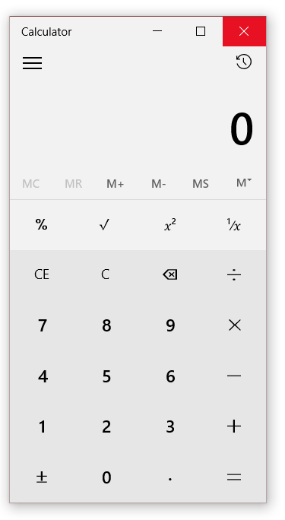
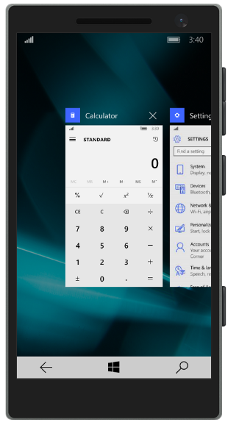
Apps can be closed by the user
Using Task Switcher on Mobile
By TitleBar ‘X’, ALT-F4, or Close touch gesture on Desktop
Running
NB: Back button does not close the app

Slide 34
Apps closed by user
When a user closes a UWP app, the app suspends and then after 10 seconds, it terminates
On next launch, get the PreviousExecutionState from the LaunchActivatedEventArgs
If ‘ClosedByUser’, you probably should not restore app state to the last point the user was in
May have closed it because it was not running correctly
May have deliberately backed out
In most cases, better to restart as a new launch

Slide 35
Other forms of Activation

Slide 36
Other Forms of Activation
You can choose to add support for other ways to activate your app
Toast
Secondary Tile (deep linking)
Cortana/Speech commands
Search contract target
Uri association
File association
Generally, you will support a specific unique UX for these, but what you should do is what is right for your app

Slide 37
Extended execution

Slide 38
Extended execution
Requesting extended execution
There is no guarantee resources are available Extended execution has no UI
Scenario “I have data this time”
Handle the Revoked event (1 second warning)
Scenario “I’m a special kind of app”
These apps run indefinitely
Special kinds of apps
Turn-by-turn (location tracking) app
Audio & VOIP application

Slide 39
Extended execution (type 1)
Running
Extend
Suspended
Request
Revoked (1 second)
Memory
No UI
(short)
When
suspending
Suspended (5 seconds/10 mobile)
Suspended
(No event)

Slide 40
Requesting extension in suspend
private async void OnSuspending(object sender, SuspendingEventArgs args) { var deferral = e.SuspendingOperation.GetDeferral(); using (var session = new ExtendedExecutionSession{ Reason = ExtendedExecutionReason.SavingData }) { session.Description = "Upload Data";
session.Revoked += (s, e) => { Log("Save incomplete"); }; try { if (await session.RequestExtensionAsync() == ExtendedExecutionResult.Denied) // takes 3 seconds
UploadBasicData(); else // takes 8 seconds
await UploadDataAsync(session); Log("Save complete"); } catch { Log("Save failed"); } finally { deferral.Complete(); } } }

Slide 41
Extend the suspension of a foreground app

Slide 42
Extended execution (type 2)
Running
Extend
Suspended
Automatic extension
Revoked (1 second)
Memory
No UI
(long running)
When
running
Special Request (during runtime)
Navigate away
Suspended
(No event)

Slide 43
Prevent the termination of a foreground app

Slide 44
Requesting extension in app
private async void InvokeMyExtension() {
if (this._session == null) {
this._session = new ExtendedExecutionSession{ Reason = ExtendedExecutionReason.LocationTracking } this._session.Description = “Driving directions";
if (await this._ session.RequestExtensionAsync() == ExtendedExecutionResult.Allowed) {
// todo approved
}
else {
// todo denied } } }

Slide 45
Enum VALUES
[ContractVersion(typeof(UniversalApiContract), 65536)]
public enum ExtendedExecutionReason
{
Unspecified = 0,
LocationTracking = 1,
SavingData = 2
}
[ContractVersion(typeof(UniversalApiContract), 65536)]
public enum ExtendedExecutionResult
{
Allowed = 0,
Denied = 1
}

Slide 46
Review
Application lifecycle
Handling Suspension
Extended execution

